Slide 1


Elementary Science
Science Focus Lesson
SC.4.E.6.3
Renewable/
Nonrenewable Resources
Polk County Public Schools
Notes:
TEST ITEM SPECIFICATIONS:
SC.4.E.6.3 Recognize that humans need resources found on Earth and that these are either renewable or nonrenewable. (Also assesses SC.4.E.6.6.)
Also Assesses
SC.4.E.6.6 Identify resources available in Florida (water, phosphate, oil, limestone, silicon, wind, and solar energy).
Benchmark Clarifications
Students will identify and/or distinguish between renewable and nonrenewable resources found on Earth.
Students will identify resources naturally found in Florida.

Slide 2
SC.4.E.6.3
Benchmark: Recognize that humans need resources found on Earth and that these are either renewable or nonrenewable.
Essential Question:
What are renewable and nonrenewable resources?
Vocabulary:
natural resources nonrenewable resources,
renewable resources fossil fuels
solar energy conservation

Slide 3
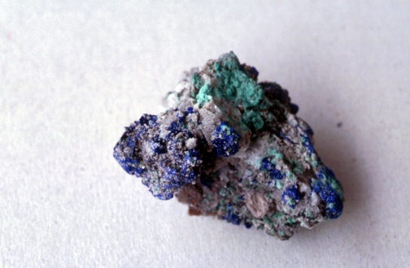
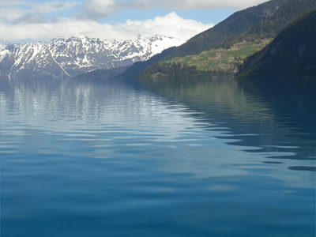
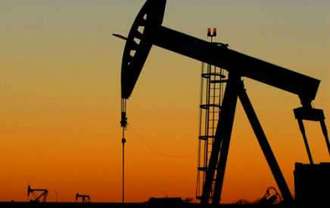
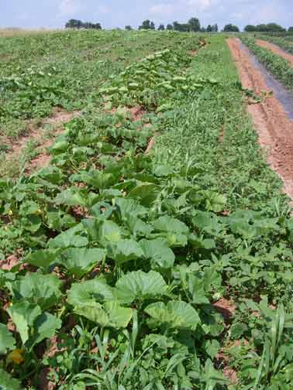


Natural Resources
Natural Resources are materials in the environment that are useful to people
Minerals
Oil
Water
Animals
Air
Plants
Notes:
Natural resources are useful for many reasons: energy, food, metals, recreation, building materials, conductors of electricity, medicines

Slide 4
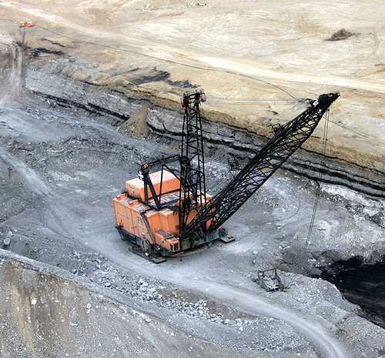
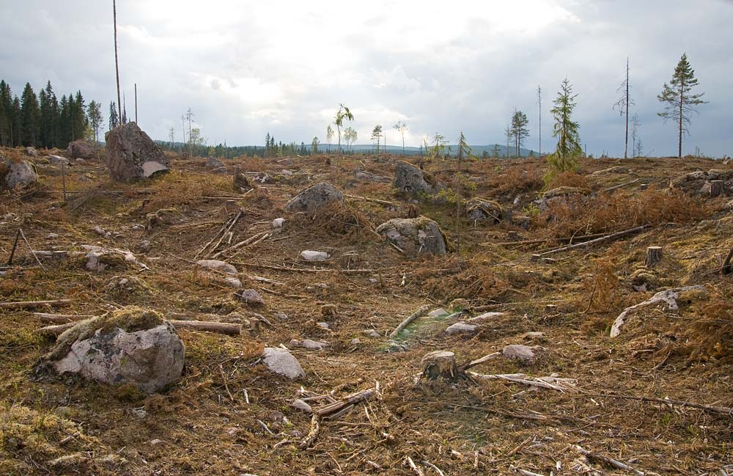
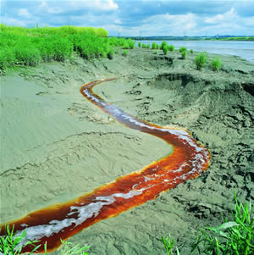
Using our resources
Getting and using natural resources can sometimes harm the environment. It is important to use resources wisely so that we don’t harm our environment.
Strip Mining
Deforestation
Water Pollution
Notes:
Discuss the fact that there is always some potential harm in the process of gathering natural resources.

Slide 5
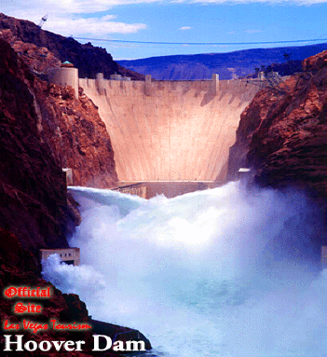
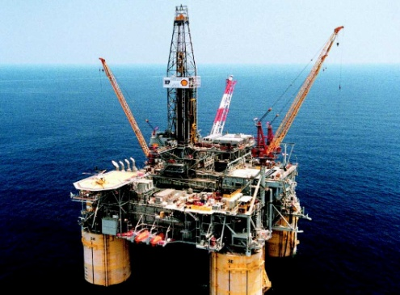
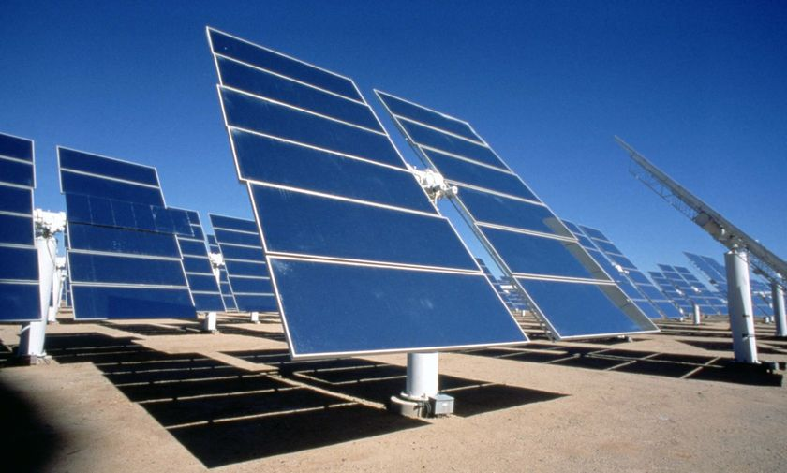
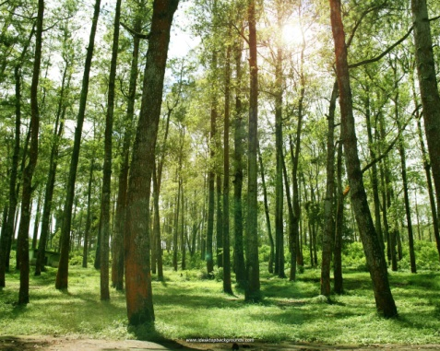
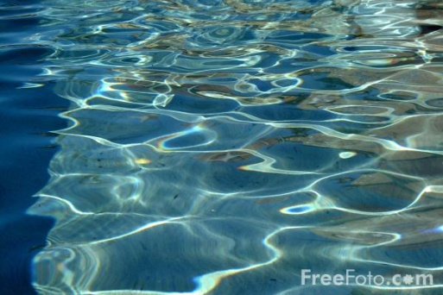
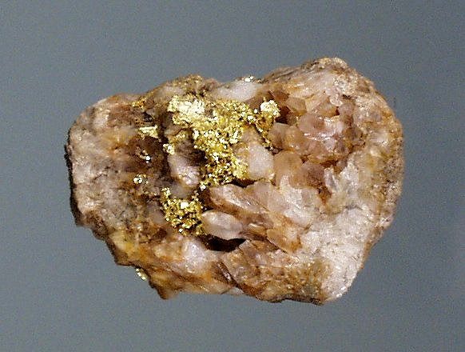
Kinds of Resources
Some resources are Energy Resources.
Oil
Solar Energy
Moving Water
Some resources are Material Resources.
Minerals
Water
Wood
Notes:
Take time to discuss various forms of Energy Resources: fossil fuels (oil/natural gas/coal), solar energy, wind energy, moving water, geothermal, biofuel. These renewable sources of Energy will hopefully become more viable as our technology improves.

Slide 6
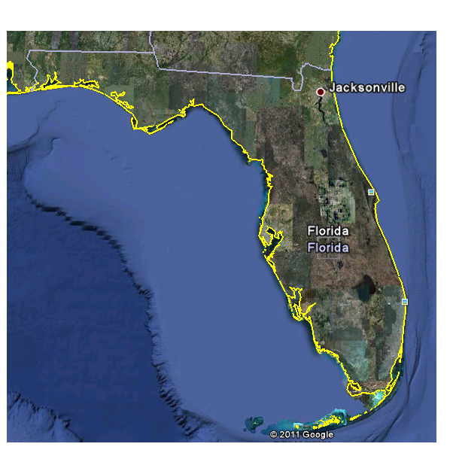
Florida’s Resources
Florida has many resources: both energy resources and material resources.
Beaches
Pine Forests
Oil
Cattle
Water
Phosphate
Citrus
Wind Energy
Solar Energy
Reefs
Notes:
(Insert Teacher instructional notes)

Slide 7
Summarizing
Talking Chips:
Each member of a cooperative group name one natural resource in Florida and explain why it is useful and important.
Notes:
Each member of the cooperative group should address a different natural resource.

Slide 8
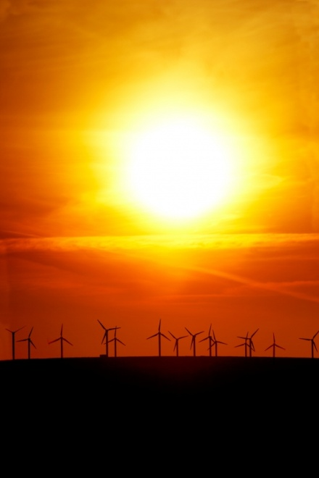
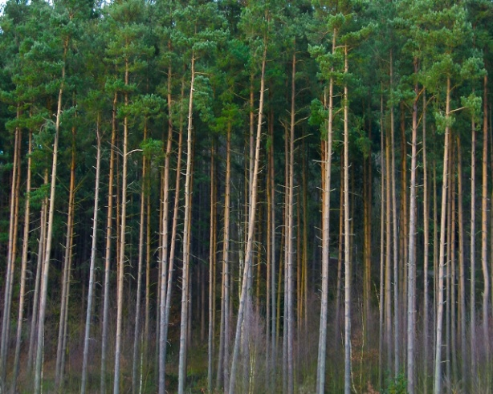
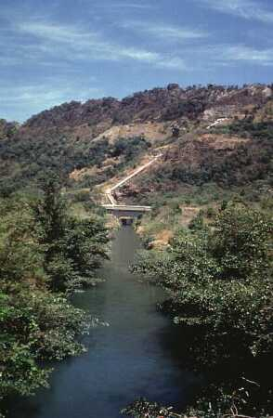
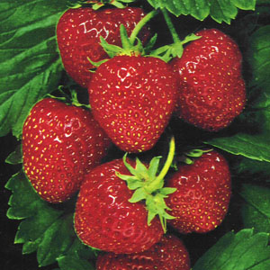
Renewable Resources
Nature can produce some resources again and again. These are called renewable resources. If we are careful we will not run out of these resources.
Fresh Water
Trees
Wind Energy
Food
Notes:
Reinforce the idea that we still need to be careful. We need to replant forests, we need to keep our fresh water supplies free of pollution, etc.

Slide 9
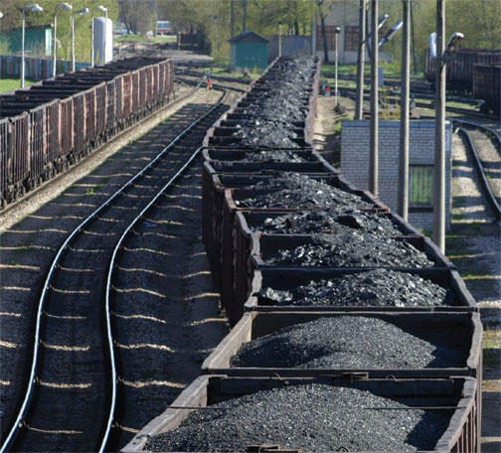
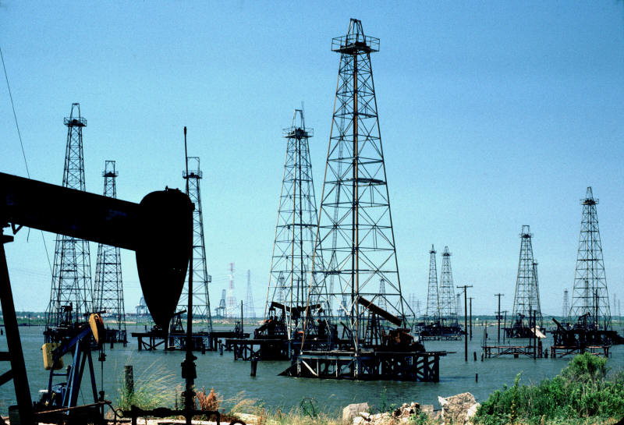
Nonrenewable Resources
The environment only holds a certain amount of some resources. When they are used up, nature cannot replace them quickly enough to meet our needs.
Oil
Coal
Notes:
(Insert Teacher instructional notes)

Slide 10
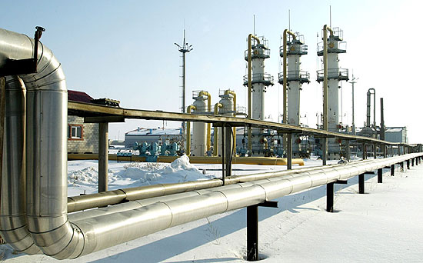
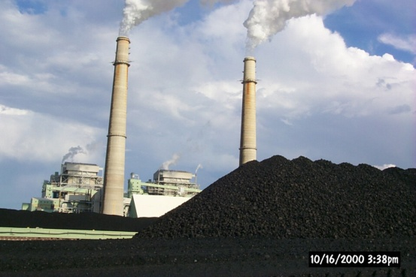
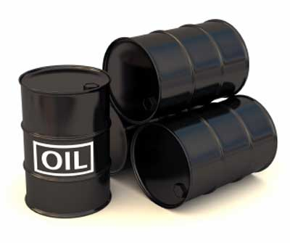
Fossil Fuels
Fuels are materials that are burned to produce heat energy. Most of the fuels we use were formed from the decayed remains of ancient plants and animals. These fuels are called fossil fuels. Fossil fuels are nonrenewable.
Coal
Natural Gas
Oil
Notes:
We rely on fuels to make our lives comfortable.

Slide 11
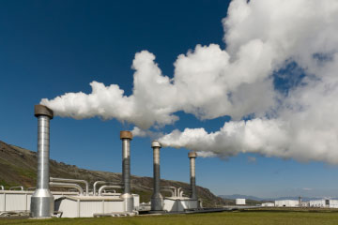
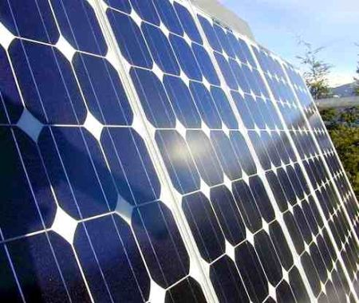
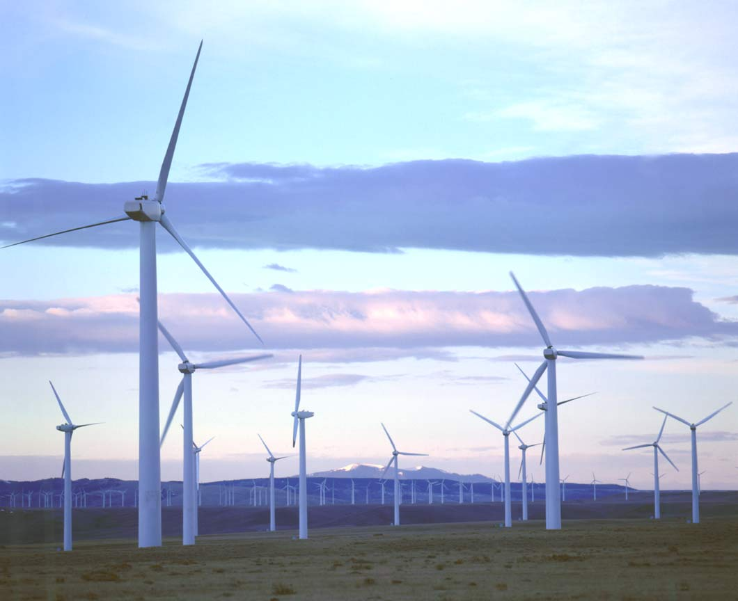
Alternative Energy Resources
Although fossil fuels are still forming today, they take millions of years to form. We use them much faster than nature can make them. Therefore, we need to make more use of renewable energy resources.
Solar Energy
Geothermal Energy
Wind Energy
Notes:
We rely on fuels to make our lives comfortable. We have the technology to use these forms of energy, but right now we cannot use them on a wide spread basis because they work best where those resources are most available (geothermal in Iceland, solar energy in Florida, wind energy in the mid west)

Slide 12

Conservation
The world doesn’t have an endless supply of natural resources. We have to make our natural resources last longer. The wise use and protection of natural resources is called conservation.
Ride your bicycle instead of driving
Buy recycled products
Use cloth shopping bags
Turn off the water while you brush your teeth
Reduce
Recycle aluminum cans
Turn off lights when you leave a room
Recycle
Reuse
Notes:
(Insert Teacher instructional notes)

Slide 13
Summarizing
3- List 3 nonrenewable resources
2- List 2 renewable resources
1- Write 1 idea for conserving
resources

Slide 14
Guided Instruction:
There are many different natural resources found in Florida. Which of the following can be described as a renewable resource?
  limestone
  oil
  phosphate
  water

Slide 15
D
The answer is…
Fresh water is a renewable resource because water is recycled by nature. However, in many places, people use fresh water faster than nature can replace it. People should only use as much fresh water as they need.

Slide 16
Guided Instruction:
Coal is a fossil fuel. Some coal miners go deep into Earth’s crust to mine this nonrenewable energy source. Coal is burned to release energy.
Which of the following best describes a risk to society caused by using coal as an energy source?
  Miners might not find any coal.
  Coal is a renewable resource.
  Burning coal causes air pollution.
  Coal is hard to find.

Slide 17
C
The answer is…
Coal is burned to release energy. However, burning fossil fuels, including coal, is the biggest source of air pollution. When fossil fuels are burned, they release harmful gases into the air.

Slide 18
Guided Instruction:
Gas is a nonrenewable resource. In general, small cars use less fuel than large cars. Very large cars such as SUVs need a lot of gas to run. Which of the following best describes what may occur if more people buy cars that use a lot of gas?
  Gas will become scarce and the price will increase.
  The amount of gas available and the price of gas will not be affected
  More gas will be produced.
  There will be no impact on society.

Slide 19
A
The answer is…
Gas comes from oil which is a nonrenewable energy resource. The more we use, the less there is available to use in the future…that means that the resource becomes scarce. When resources are scarce they become more expensive.
Notes:
This is an economic concept and may need further explanation. The oil industry will be able to charge more for a barrel of oil because people are not willing to go without their car and will, therefore, be willing to pay a greater amount for something that they perceive as a NEED.

Slide 20
Guided Instruction:
Hoover Dam is located in the western part of the United States. At Hoover Dam, the energy of moving water is used to produce electricity. Which natural resource will structures like the Hoover Dam help us conserve?
  fossil fuels
  trees
  water
  fish

Slide 21
A
The answer is…
Fossil Fuels are ENERGY RESOURCES and moving water can also be used to generate electricity to supply us with ENERGY. Fossil Fuels are nonrenewable energy resources so it would be better to replace some of our energy needs with renewable energy resources like moving water.

Slide 22
Summarizing
Tell your shoulder partner why we should conserve all natural resources.
Notes:
All resources should be conserved because they are all things that are useful to human beings. Even though nature can replace renewable resources, sometimes getting those natural resources is harmful to our Earth. Therefore, the less that we need to gather, the better for our Earth. Nonrenewable resources cannot be replaced quickly enough and therefore we could run out if we don’t conserve. We would all suffer if we were not able to gather the natural resources that we use.

Slide 23
Check Your Understanding
Answer these questions independently. Check your answers at the end.
1. The United States has a limited supply of oil. We must move oil long distances to places we need it. Sometimes this oil is spilled as it is being moved. What effect might an oil spill have on the environment?
  It will make the soil better for growing plants.
  It will harm plants and wildlife.
  It will cause global warming.
  It will clean up easily and not hurt the environment.

Slide 24
Check Your Understanding
2. Some scientists warn that if people continue to consume the amount of oil and gas they are now using, the supply could run out. Scientists are working to find new ways to meet energy needs. Which of the following renewable energy resources is presently being used to operate experimental cars, heat water, and warm homes?
  the Sun
  the wind
  the tides
  wood

Slide 25
Check Your Understanding
3. In some places, moving water is used instead of fossil fuel to make electricity. How does this help us to conserve natural resources?
  water is a renewable resource.
  our water supply is increased.
  the amount of fossil fuel we have increases.
  electricity is conserved.

Slide 26
Check Your Understanding
4. In what ways do renewable resources differ from nonrenewable resources?
  renewable resources supply most of our energy needs
  you cannot burn any renewable resources
  renewable resources can be replaced more easily than nonrenewable ones
  there are no differences

Slide 27
Check Your Understanding
5. Why are nonrewable energy sources hard to replace?
  replacing them causes pollution
  they cost too much to reproduce
  they would take millions of years to re-form
  Earth has so many of them it is not necessary

Slide 28
Check Your Answers
b-it would be helpful to reduce our dependence on oil because it can cause harm to our environment
a-we already use solar energy to heat water and in some cases to heat entire homes
a- the amount of water in our environment never changes, we will not run out of water
c- we need to be careful with our use of all resources, however renewable resources are easier to replace than nonrewable
c- nonrewable resources are fossil fuels which form over millions of years
Notes:
Add rationale for answers here.

Slide 29
Summary Question
Write a summarizing paragraph to describe reasons why natural resources are useful to humans. Include at least 3 reasons why we need our resources.
Notes:
Set a high standard for a written summary: Topic sentence, 3-4 supporting sentences. We need Energy resources for transportation, electricity, manufacturing, etc. We need food, metals to build things, building materials, etc.

