Slide 1


Elementary Science
Science Focus Lesson
SC.5.P.13.1
Force and Motion
Polk County Public Schools
Notes:
Benchmark Clarifications
Students will identify familiar forces that affect how objects move. Students will identify scenarios whereby gravity is overcome.
Students will identify and/or describe examples of magnetic attraction and repulsion.
Content Limits
Items assessing familiar forces are limited to pushes, pulls, friction, gravity, and magnetic force.
Items may only require the interpretation of two forces at a time.
Items referring to friction will only assess the force of friction as a resistance to movement.
Items that assess magnetic attraction will not use the context of separating mixtures and solutions.

Slide 2
SC. 5.P.13.1
Benchmark: Identify familiar forces that cause objects to move, such as pushes or pulls, including gravity acting on falling objects.
Essential Question:
How is the motion of an object affected by the forces acting upon the object?
Vocabulary:
force magnetic force
gravity friction
Notes:
Force- The capacity to do work or cause physical change
Gravity-The natural force that pulls objects towards the earth.
Magnetic force- The force exerted between magnetic poles, producing magnetization
Friction- Friction is a force between two surfaces rubbing against each other. Friction works against the motion of an object.

Slide 3
What is a force?
A force is a push or a pull.
Forces allow objects to start moving,
stop moving, change speed or direction.
Talk it over….
What are some objects that are pushed?
What are some objects that are pulled?
Notes:
A push or a pull is necessary to start an object in motion. Gravity is one example of a pull that could start an object moving.
Objects pushed - shopping cart, stroller, swing, volley ball, baseball, bicycle pedal, walking, rockets, etc.
Objects pulled – wagon, pull a chair out from the desk, pick up your bike off the ground, open your book, open the door, raking leaves, etc.

Slide 4
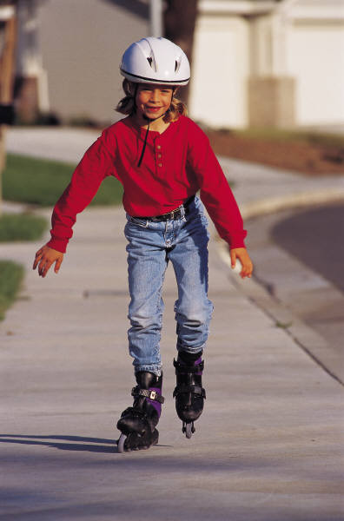
How does force affect the motion of the skater?
When you skate, your skate pushes against the ground and moves you forward.
Notes:
Walking and skating in an example of a push that allows people to move.

Slide 5
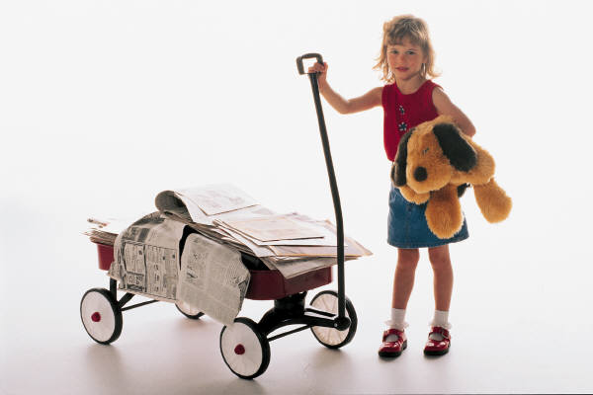
How does force affect the motion of the wagon?
A pull will start the wagon in motion.
The more mass you have stored in your wagon, the more force you will need to start the wagon moving.
Notes:
Pulling a wagon is an example of a “pull” that will start objects moving. The heavier an object is the harder it is to start moving or stop moving. This will be covered in more detail later.

Slide 6
Gravity
Gravity is the force that pulls objects toward each other.
We are most familiar with the gravitational pull of the Earth.
Objects are “pulled” to the ground by gravity.
Objects also stay on the ground because gravity is pulling them to the Earth.

Slide 7


What happens when you drop two objects?
Try it….
Drop a book and a pencil at the same time.
Which one hits the ground first?
Make sure you keep the variables constant….
Notes:
Both objects will hit the ground at the same time. Be careful to choose objects of similar shape so that their trial is not affected by air resistance.
Keep the variables constant…Be sure both items are held at the same level and released at the same time.

Slide 8

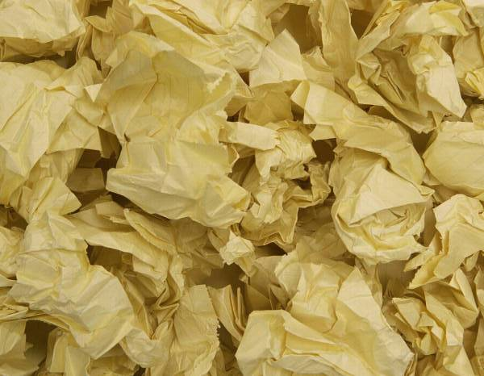
Try it again…
What happens when you drop a flat sheet of paper and a paper ball?
Will they hit the ground at the same time like the paper ball and the pencil?
What caused them to hit the ground at different times?

Slide 9

Air resistance
As an object falls to the ground the air around it is slowing it down.
The more surface area an object has the more air resistance it will experience.

Slide 10
Summarizing
In your science notebook…
1. Give two examples of gravity pulling objects to the ground.
2. Answer in your own words,
What is gravity?

Slide 11
What is friction?
Friction is a force between two surfaces rubbing against each other. Friction works against the motion of an object.
Rough surfaces have more friction than smooth surfaces.
Can you think of some examples of friction at work?
Notes:
Friction causes a ball to stop rolling, brakes of a bike or car to work, etc.

Slide 12
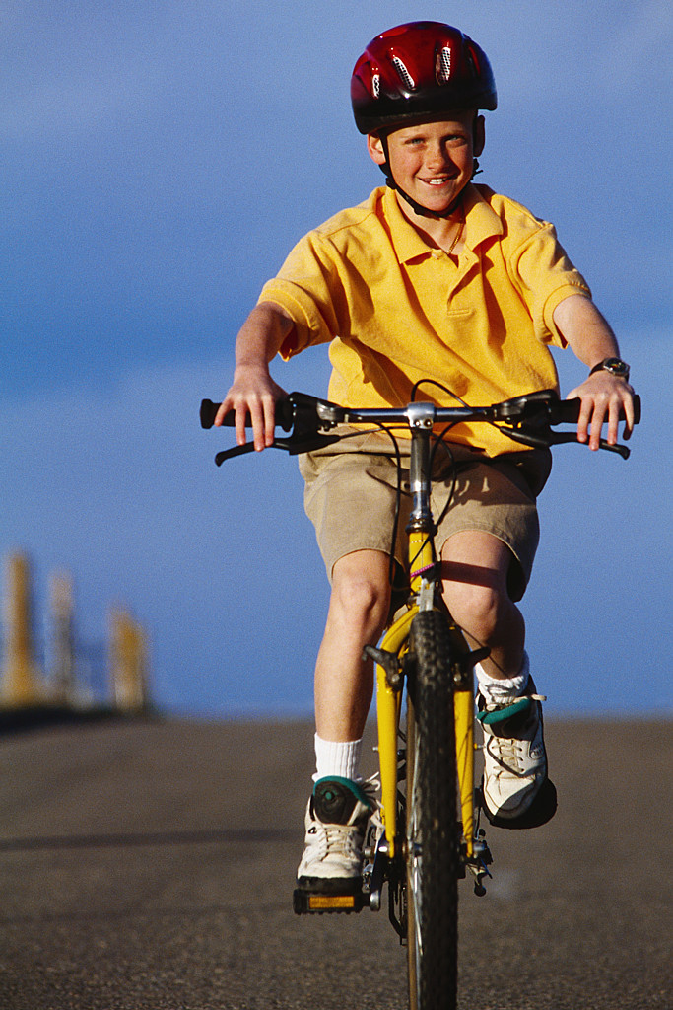
What do you think?
A bicycle traveling on a sidewalk will stop easier than a bicycle traveling on a dirt path.
Remember: A rougher surface produces more friction than a smooth surface.
The force of friction can also be reduced, making objects move easier. (icy or snowy road or a wet floor)

Slide 13
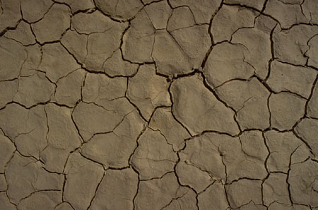
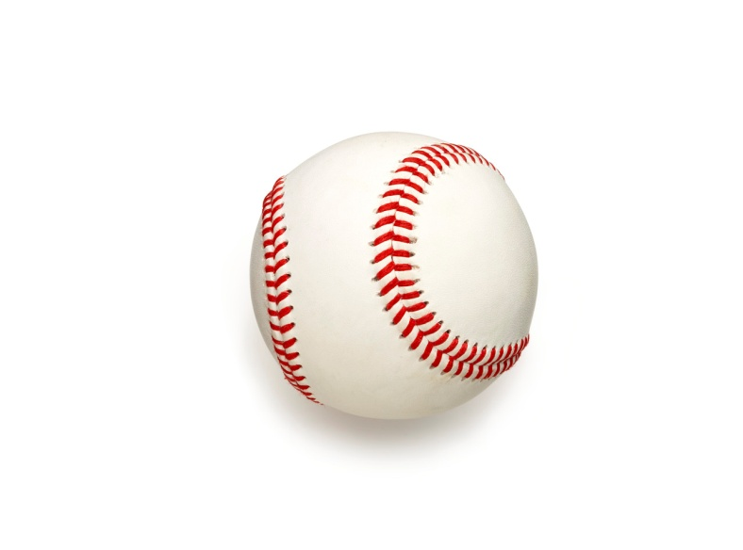

What do you think?
If a baseball is hit with the same force, on which surface will it roll the farthest? Why?
Notes:
Answers should explain that the ball will roll farthest on the dirt surface because it is smoother.

Slide 14

Click on the camera viewer to watch a video segment about friction.
Notes:
To start the video click the camera. To enlarge the screen when the video starts click the square on the right side of the screen with the arrow in it. When the video ends press escape to close the video screen by clicking the x in the top right of the screen.

Slide 15
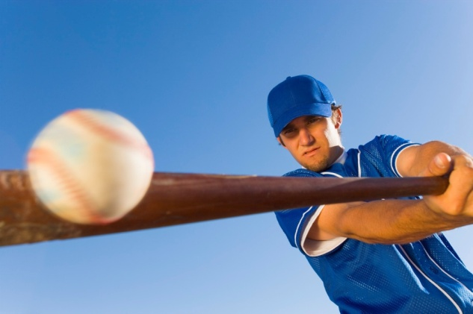
Summarizing
Answer the following question in your notebook:
A baseball player hits a ball, it rolls into the outfield and then stops.
Explain what forces start the ball moving and cause the ball to finally stop.
Notes:
Hitting the ball with the bat is a force (push) that puts the ball in motion. Air resistance and gravity causes the ball to slow and fall to the ground. Friction between the ball and the grass causes the ball to eventually stop rolling.
Discuss student summaries to ensure they recognize all forces at work.

Slide 16
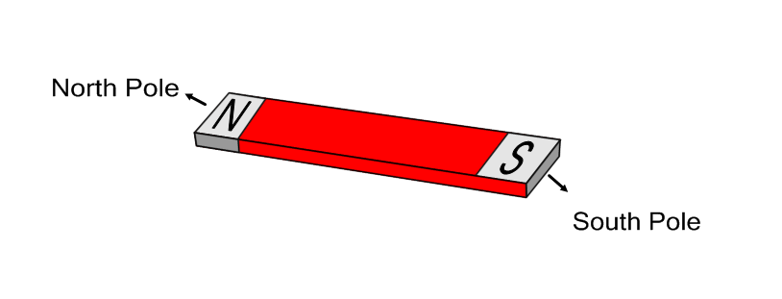
What is magnetic force?
Magnetism is a property of some matter.
Magnets have two poles.
One is called the North Pole. The other pole is called the south pole.

Slide 17
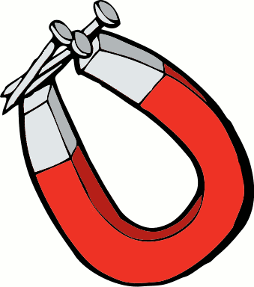
When two magnets are close, they create pushing (repel) or pulling (attract) forces on one another. These forces are strongest at the poles of magnets.
Magnets attract objects made of iron or steel.

Slide 18
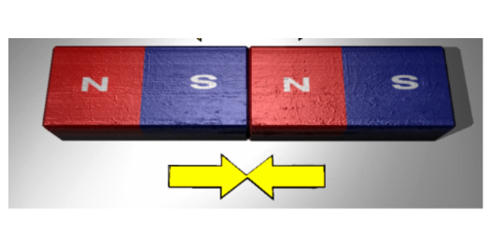
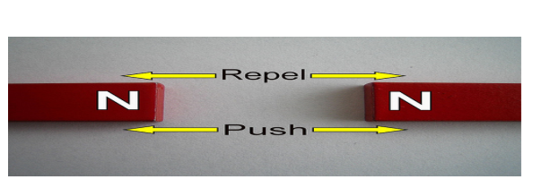
Opposites Attract!
If you put two magnets together with different poles pointing towards one another, the magnets will ATTRACT (pull towards) each other.
If you try to put two magnets together with the same poles pointing towards one another, the magnets will REPEL(push away from) each other.

Slide 19
1. A circus acrobat was shot out of a cannon. As she flew across the room, she began to fall down toward the net.
What force caused the acrobat to fall down toward the net?
A. friction
B. heat
C. gravity
D. wind

Slide 20
1. C is correct!!!
Gravity is the force that pulls objects to the ground.

Slide 21
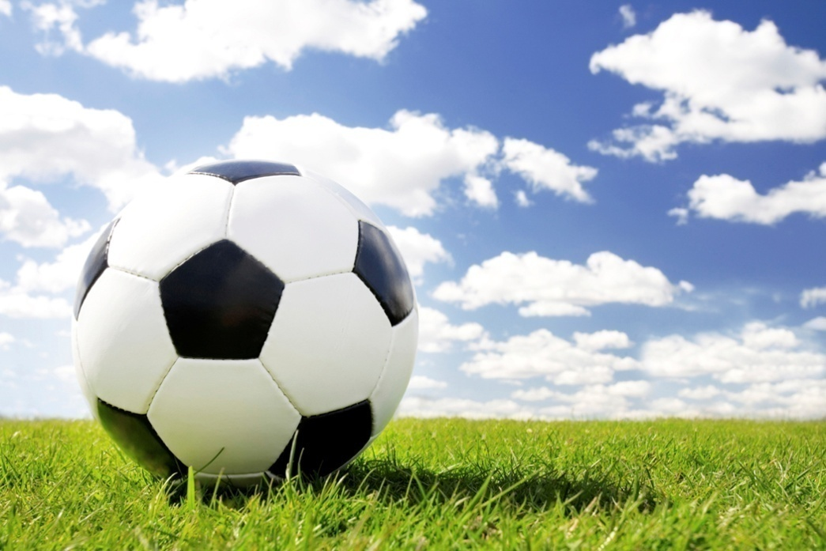
2. A rolling ball will slow down until it finally stops. What force slows down and stops the ball?
A. gravity
B. solar power
C. friction
D. speed

Slide 22
2. C is correct!!!
Friction is the force that slows objects down and causes them to eventually stop.

Slide 23
3. A soldier with a parachute jumped out of an airplane. After he opened his parachute, he fell more slowly.
What upward force slowed down his fall?
A. gravity
B. friction
C. air resistance
D. weight

Slide 24
3. C is correct!!!
Remember dropping the flat sheet of paper? The air resistance slowed down its fall to the ground. A parachute acts the same way, making it safe for people to jump out of planes.

Slide 25
4. Mike lifted a heavy box. What force did he have to overcome to move the box upward?
A. gravity
B. air resistance
C. friction
D. muscular

Slide 26
4. A is correct!!!
Gravity is the force that pulls objects to the ground, but it is also the force that holds objects, and us, to the ground.

Slide 27
Summarizing
How is the motion of an object affected by the forces acting upon the object?
Answer this question using the following words.
gravity
friction
magnetic force
push or pull
force
Notes:
Possible response: A force is a push or pull that is need to start objects moving. Gravity is a force that pulls objects to the ground. Once objects are moving they can be slowed down or stopped by friction. A magnetic force is when a magnetized piece of either iron, steel, nickel or cobalt comes close to either an other magnet or an demagnetized piece of iron, steel, nickel or cobalt. This is measured in newtons.

Slide 28
Check Your Understanding
William used a hammer to pound a nail into a wooden board. When the nail was about halfway through the board, he stopped and turned the board upside down. The nail stayed in place in the board. Which of the following acts on the nail to keep it in place in the board?
A. Friction
B. Gravity
C. Magnetism
D. Weight

Slide 29
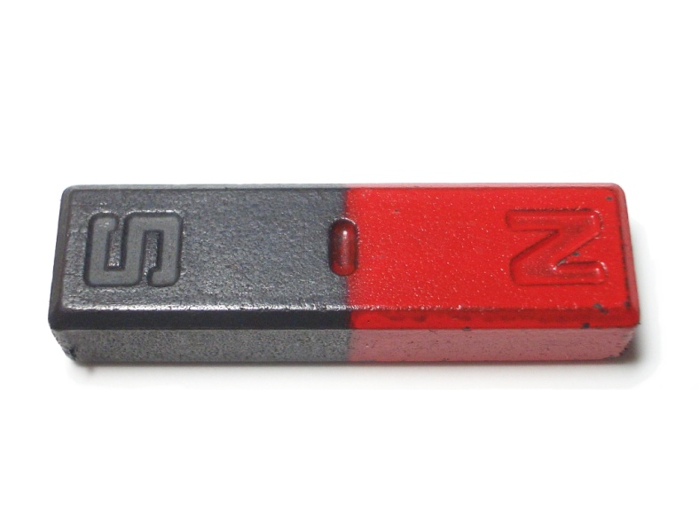
Check Your Understanding
Jamesha has a bar magnet.
What will happen when she brings the north end of her magnet to the south end of Brittany’s magnet?
A. They will attract
B. Nothing will happen
C. They will repel
D. Sparks will fly

Slide 30
Check Your Understanding
Juan and Kathleen bought model rocket kits. They built identical rockets with identical engines. Juan, however, glued small pieces of a broken bicycle reflector to his rocket to make it more visible in the sky.
If everything is the same on both rockets except for the reflector pieces, which rocket will travel higher when they are launched at the exact same time?

Slide 31
Check Your Answers
A. Friction
A. They will attract
Kathleen’s Rocket
Notes:
When the board is turned upside down, the nail will only stay in place if the forces are balanced. Gravity is pulling the nail down, and friction is acting in the opposite direction.
Opposites attract
Kathleen’s rocket has less mass and less air resistance. The reflectors give Juan’s rocket more mass than Kathleen’s

Slide 32

Summary Question
How is the motion of an object affected by the forces acting upon the object?

